Slide 1

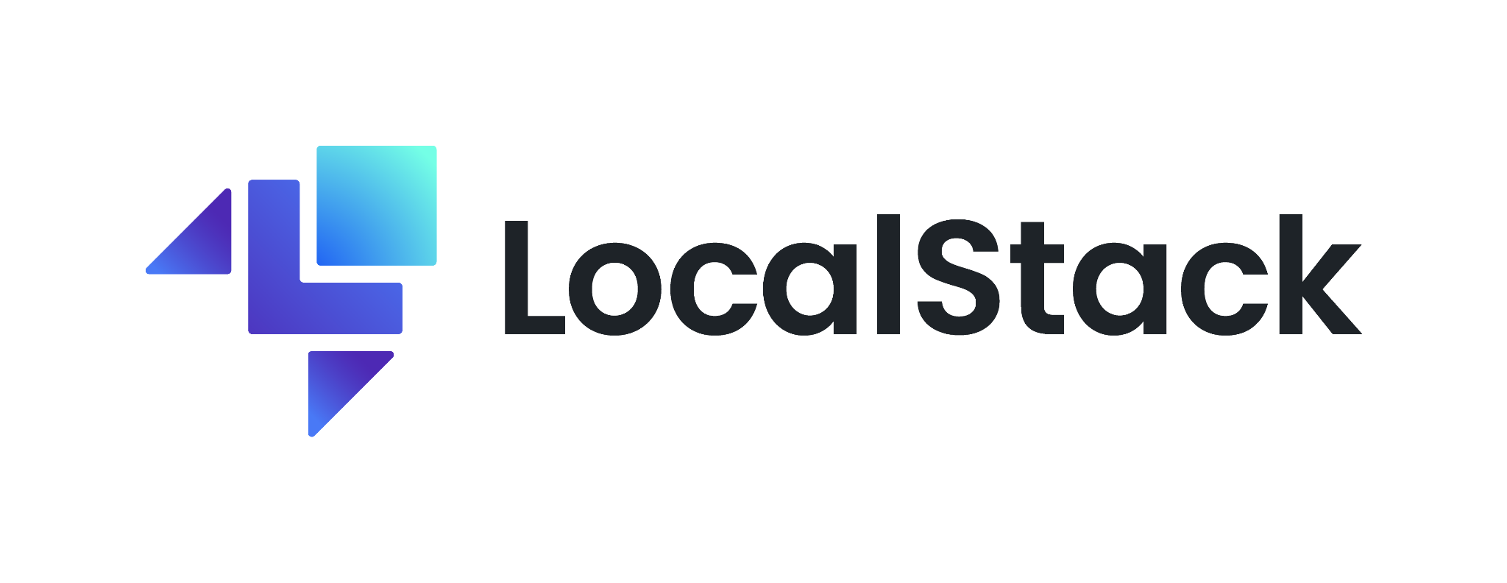
Tutorial: Develop your Python cloud applications offline with LocalStack
EuroPython 2023, July 18th, Prague
Waldemar Hummer
Thomas Rausch Alexander Rashed
localstack.cloud

Slide 2
Agenda
Intro to LocalStack
General background and overview
Basic installation and setup
Developing Python Lambdas and Serverless applications locally
Serverless image resizer sample application
Lambda hot reloading
Integration with Infrastructure-as-Code (IaC)
Developing an AppSync sample with CDK
Brief overview of other IaC frameworks (Terraform, Pulumi) with LocalStack
Advanced Topics & Team Collaboration
State sharing via Cloud Pods
Wrap up and outlook on future work

Slide 3
Intro
Quick mini survey:
Do you have experience with AWS cloud?
→ used it for hobby projects?
→ use it in a professional setting on a daily basis?
Have you worked with LocalStack before?
Do you have experience with Infrastructure-as-Code tools? (Terraform, CDK, …)

Slide 4
Some downloading in the background… :)
Before we continue with a short intro…
IF you have Docker installed locally, you can start pulling this image:
docker pull localstack/localstack-pro
pip install 'awscli-local[ver1]'
pip install 'awscli-local[ver1]'

Slide 5

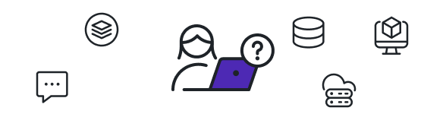
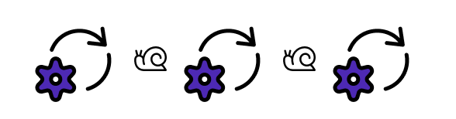
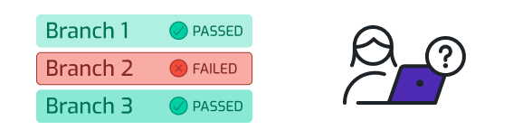
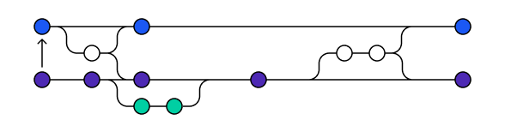
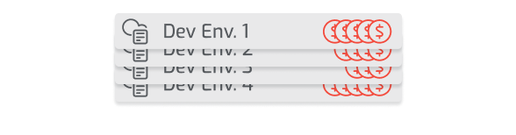
1
2
Context:
Today’s Cloud Development is Slow, Tedious, & Costly
Alice is tasked with creating a new serverless Web application on AWS Cloud.
Developing on her local machine, she realizes that there are lots of dependencies with resources in the cloud (DBs, VMs, MQs, S3, …)
3
4
Alice realizes that the dev&test loop is extremely slow and tedious. Every local change needs to be packaged and uploaded to the cloud for testing.
Alice has a red build on her feature branch, but has troubles efficiently testing and debugging her code in the CI/CD pipeline.
5
6
Alice and her team are using Git flow for development - one CI build per feature branch. There is an explosion of different environments required for testing (branches * developers).
The dev manager approaches the team and complains that AWS test resources are not being cleaned up properly (causing a substantial cost spike in the last months).

Slide 6
What is LocalStack?
A fully functional local cloud stack - Develop your AWS cloud apps locally!
Enables a highly efficient dev&test loop for cloud apps
Ships as a Docker image, easy to install and start up
Support for ~70 AWS APIs (and growing):
compute (e.g., Lambda, ECS, EKS)
various databases (e.g., DynamoDB, RDS, DocumentDB)
messaging (e.g., SQS, Kinesis, MSK)
some sophisticated/exotic APIs (e.g., QLDB, Athena, Glue)
Advanced collaboration features and CI integrations
redefining the way cloud apps are developed across the lifecycle!

Slide 7





Our Story
47.000+
GITHUB STARS
Release of LocalStack version 2.0.0
Release of LocalStack version 1.0.0
150.000.000+
Reached 20+ team members, and growing!
DOCKER PULLS
Reaching 25.000 stars on GitHub,
50+ AWS services supported in LocalStack
20.000+
LocalStack Pro extensions
first version available
SLACK MEMBERS
Reaching 10.000
stars on GitHub
460+
First open source commits of
LocalStack in GitHub repository
CONTRIBUTORS
2016 August
2018
March
2019
July
2020
July
2022
May
2022
July
2023
March

Slide 8
Installation & Getting Started

Slide 9
Configuring the API Key
LocalStack provides different product tiers
Open Source (Community) version
LocalStack Pro / Team / Enterprise
Some features in the demo will require advanced Pro/Team features
→ we’ll configure an API key to enable these features
We have prepared a special trial API key for this tutorial: ls-ep-23-demo
Please make sure to configure this in all terminal sessions:
export LOCALSTACK_API_KEY=ls-ep-23-demo

Slide 10
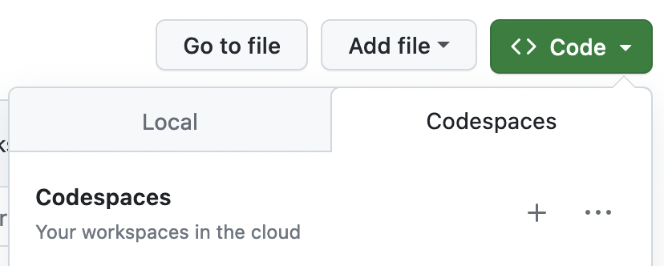
Two Installation Options
Repository with code samples:
https://github.com/localstack/localstack-workshop
Option 1: Install LocalStack on the local machine (requires Docker)
Clone project onto your local machine
Install the CLI via pip:
Start up LocalStack:
Option 2: Use an online IDE (Github Codespace) to follow the tutorial
Open the repo link on Github
Launch the project in a Github Codespaces environment
pip install --pre localstack
localstack start

Slide 11
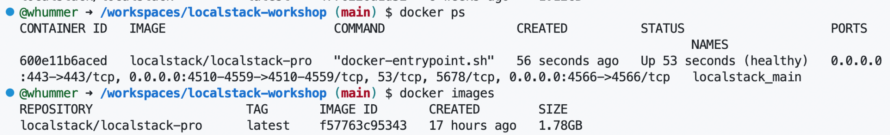
Installation Result
After successful installation and startup, you should see something like this:
Common issues and resolutions:
If you get a startup error related to port 53, try:
Make sure the localstack/localstack-pro image is used (otherwise check API key)
export DNS_ADDRESS=0

Slide 12
Configuration Options
LocalStack is a highly configurable platform
Network configs (e.g., ports, Docker network, …)
Service-specific configurations (e.g., Kinesis latency, ECS Docker flags, …)
Lambda configs (e.g., local code mounting, executor mode, …)
Debug settings (e.g., verbose logs, debug ports)
Persistence settings (e.g., data directory, persistence mode, …)
…
Sensible defaults used for most configs, based on the user’s environment
Utilities to validate the config: “localstack config validate” CLI
More details in our online docs: https://docs.localstack.cloud

Slide 13
Getting Started:
S3 Website - Hello World!

Slide 14
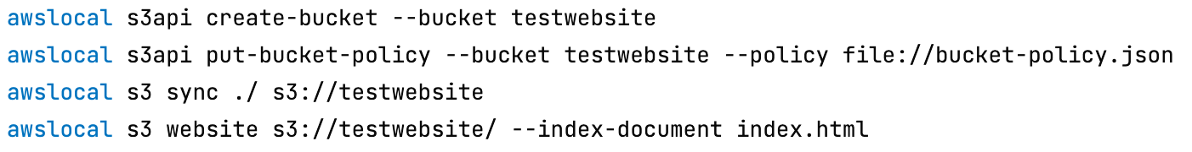
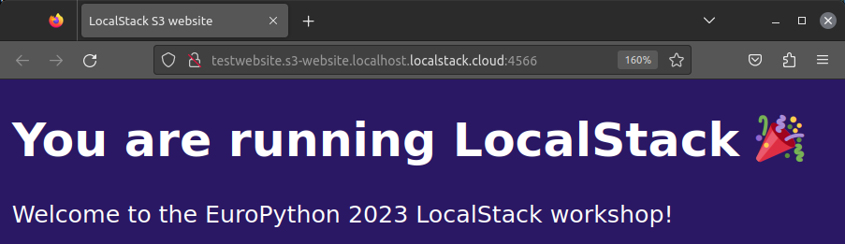
Hello World - S3 Website App
See depoy.sh script in the hello-world/ folder in the repo
Once deployed, we can open the S3 website in the browser
http://testwebsite.s3-website.localhost.localstack.cloud:4566

Slide 15
Web Application
LocalStack offers a graphical Web user interface
Usage dashboard, account management, …
Resource Browser - simplified version of the AWS Console locally
https://app.localstack.cloud
Feel free to sign up for a user account directly!
Alternatively, we’ve prepared a demo account for this tutorial:
Username:
Password:
demo@localstack.cloud
EuroPython23!

Slide 16
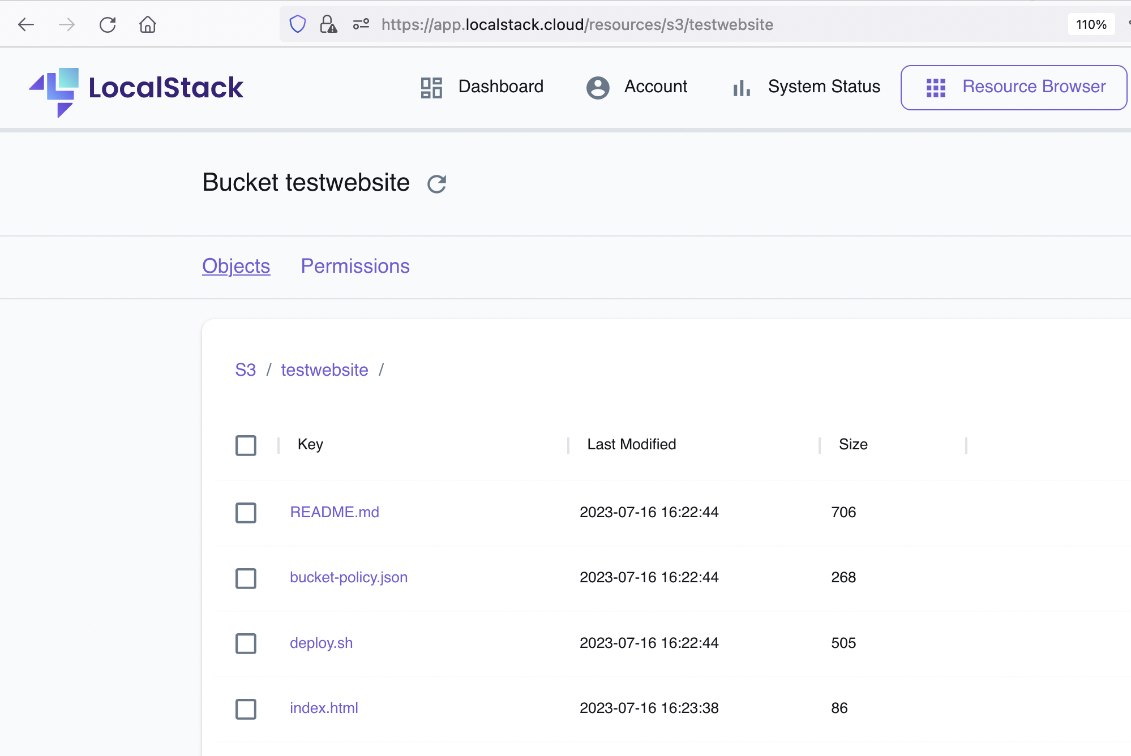
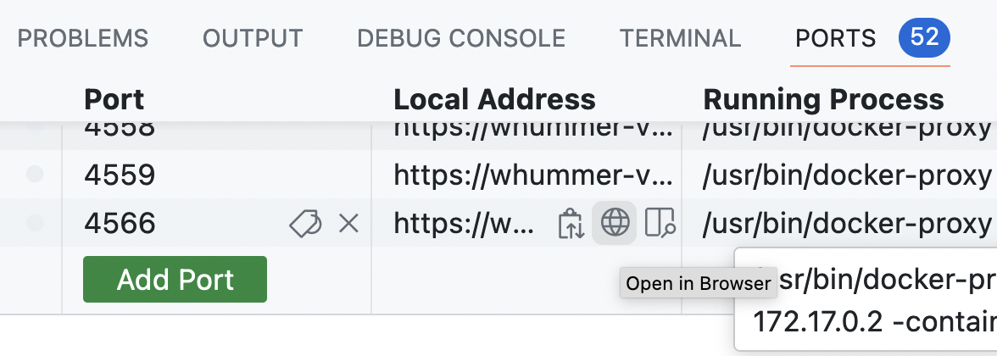
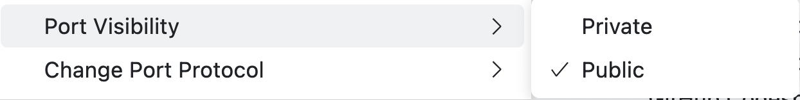
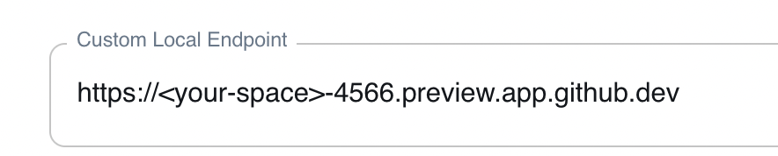
Web App - Resource Browser
We can use the Resource Browser to inspect the files in our local S3 bucket:
Note: In Codespaces we need to configure the Web app to use the custom endpoint URL to connect to:

Slide 17
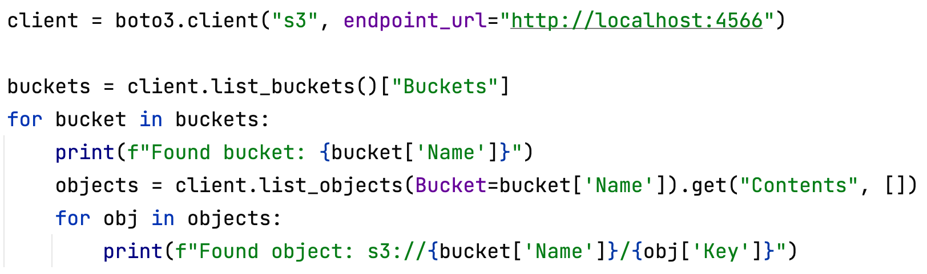
Connecting to AWS from Python
AWS provides SDKs for various programming languages (Java, Go, .NET, Node.js, …)
For Python, the official AWS SDK is called boto3 (https://github.com/boto/boto3)
→ we will see this quite frequently in our sample apps
Simple example of connecting to S3 - listing all buckets and objects:
run python list_s3_objects.py in the repo

Slide 18
Sample 1: Serverless Image Resizer

Slide 19
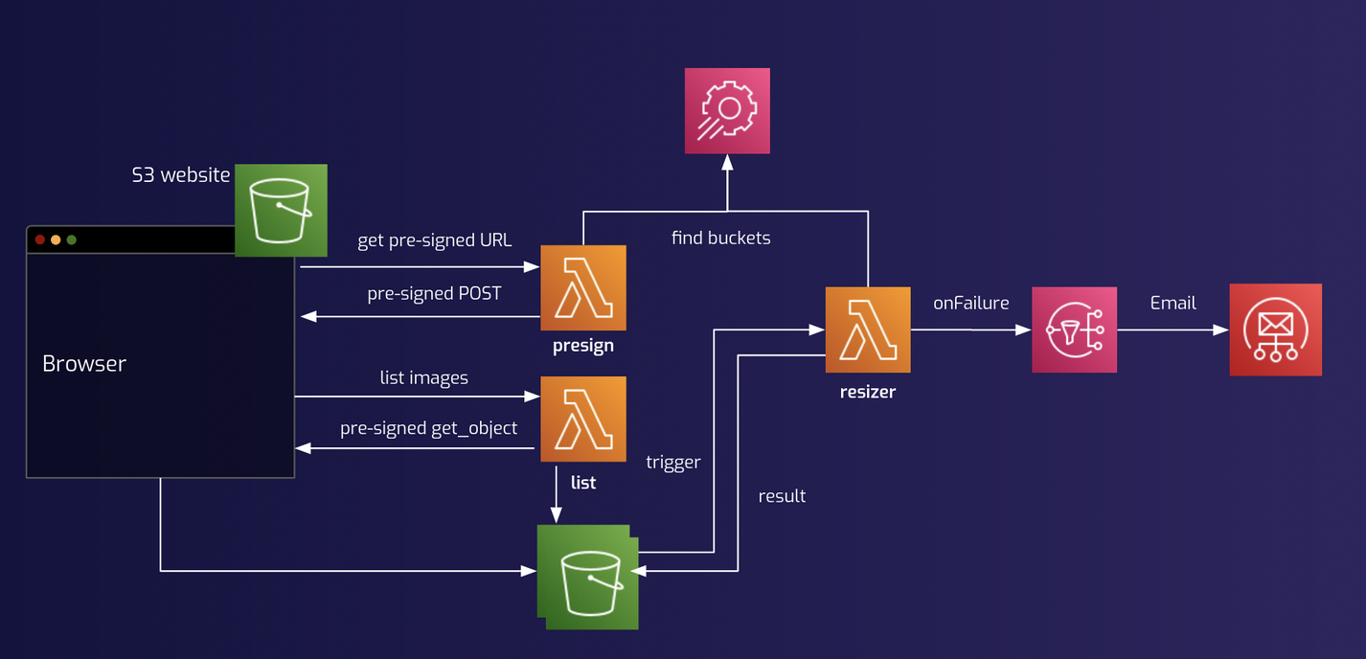
Application Architecture
Allows to resize images
Upload image files to S3
Triggers a Lambda
Result is put back onto S3
Covers several AWS services
Lambda functions
S3 bucket
SSM parameter
SNS failure notification
Ships with a simple Web UI

Slide 20
Installation
To install the sample application, we can use the bin/deploy.sh script in 01-serverless-image-resizer/
The installation script performs the following steps:
Creates basic infrastructure: the S3 bucket, SSM parameters, SNS topics
Creates the Lambda functions for (1) list, (2) presign, and (3) resizing
Note: the resizer Lambda depends on some image modification libraries (pillow) - for MacOS the build is executed in a Docker container, to avoid compile conflicts
Creates an API Gateway to expose the Lambdas via an HTTP endpoint
Finally, the script uploads the HTML/JavaScript sources for the WebUI
→ see next slide on how to use the UI

Slide 21
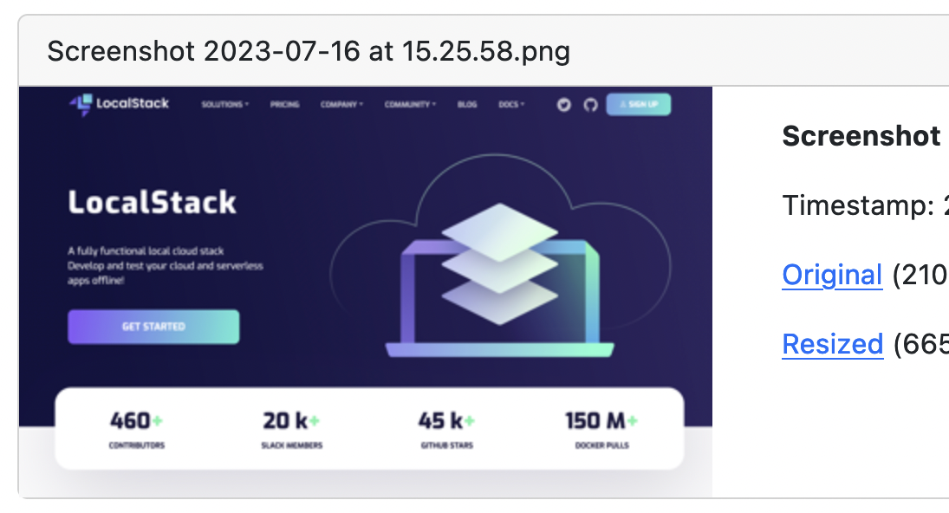
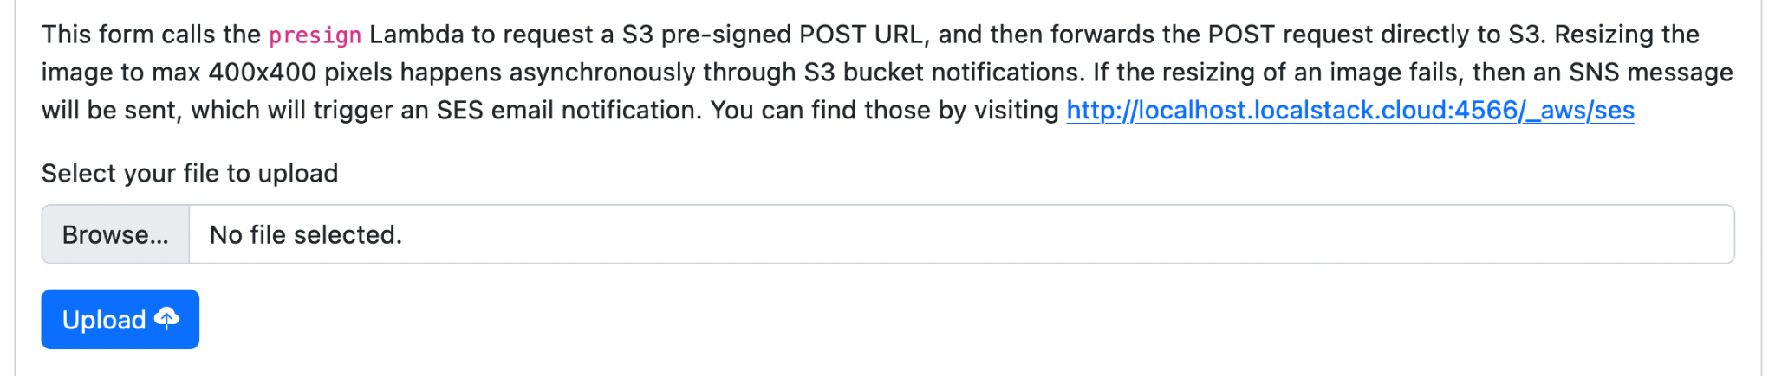
Resizer Web UI
Web UI to upload and resize images
Once the app is deployed, the Web UI is accessible here:
Locally: http://webapp.s3-website.localhost.localstack.cloud:4566
Codespace: https://<your-space>-4566.preview.app.github.dev/webapp/index.html

Slide 22
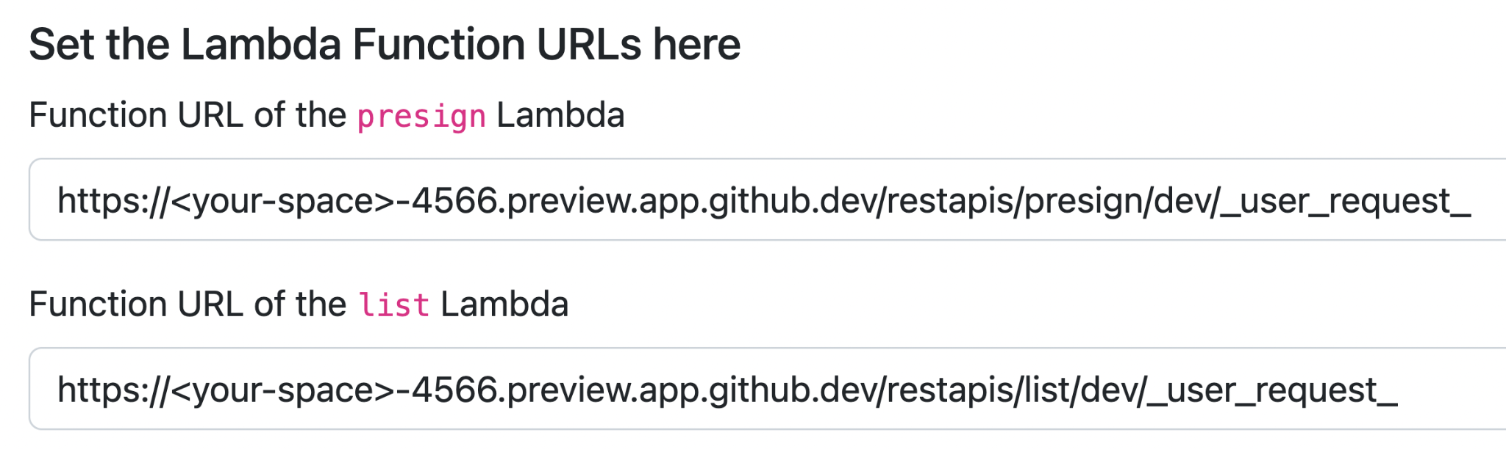
Resizer Web UI - Configuration
The Web UI needs to be configured with the .
Copy the output from these commands:
Note: For Codespaces, we need to configure slightly different endpoints:
<your-space-port-4566>/restapis/presign/dev/_user_request_
<your-space-port-4566>/restapis/list/dev/_user_request_
awslocal lambda list-function-url-configs --function-name presign
awslocal lambda list-function-url-configs --function-name list

Slide 23
Lambda Hot Reloading
What if we want to make changes to the existing functionality?
With hot reloading, changes are immediately reflected (→ fast feedback cycles!)
We’ll now extend the example and modify the “list” Lambda function:
See the hint in the bin/deploy.sh script
We can now modify the Lambda handler → the result is immediately reflected in the UI
→ see notes in the file lambdas/list/handler.py
awslocal lambda update-function-code --function-name list \
--s3-bucket hot-reload --s3-key "$(pwd)/lambdas/list"
special bucket name
absolute path to Lambda code

Slide 24
Sample 3: AppSync GraphQL API with CDK

Slide 25
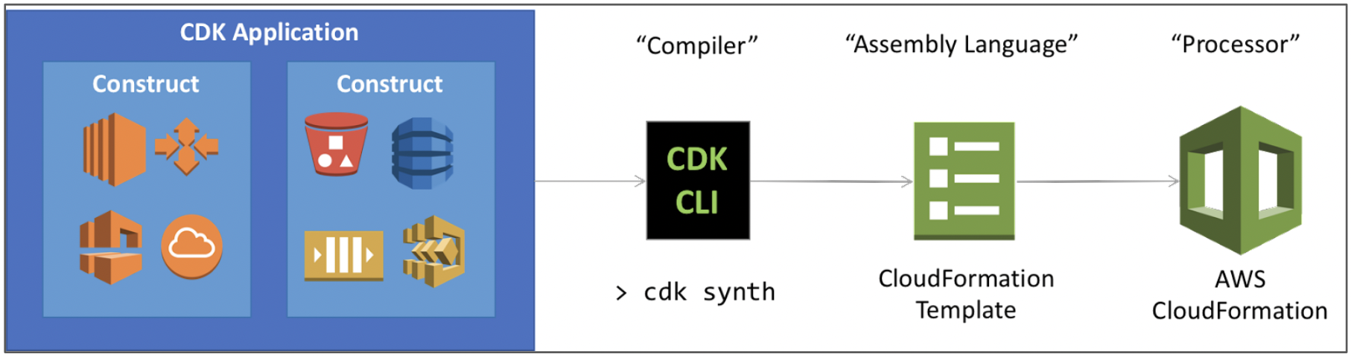
AWS Cloud Development Kit (CDK)
AWS CDK is a popular tool to define your Infrastructure as Code (IaC)
Offers bindings for various programming languages
Python, TypeScript, Go, Java, …
On deployment, CDK programs are compiled into CloudFormation stacks
The CLI tool cdklocal simplifies deploying CDK stacks against LocalStack
https://github.com/localstack/aws-cdk-local

Slide 26
Sample Application - AppSync GraphQL
CDK script defines resources in Python
Creates an AppSync application:
GraphQL schema
DynamoDB table
RDS database
Resolver mappings
…
Run a GraphQL mutation to add items
Run a GraphQL query to retrieve items
LocalStack
GraphQL Schema
type Query {
...
}
type Mutation {
...
}
RDS Postgres table “items”
extract data
DynamoDB table “items”
parse schema
AppSync API
send GraphQL query
return result
receive notifications
Client
WebSocket
Client

Slide 27
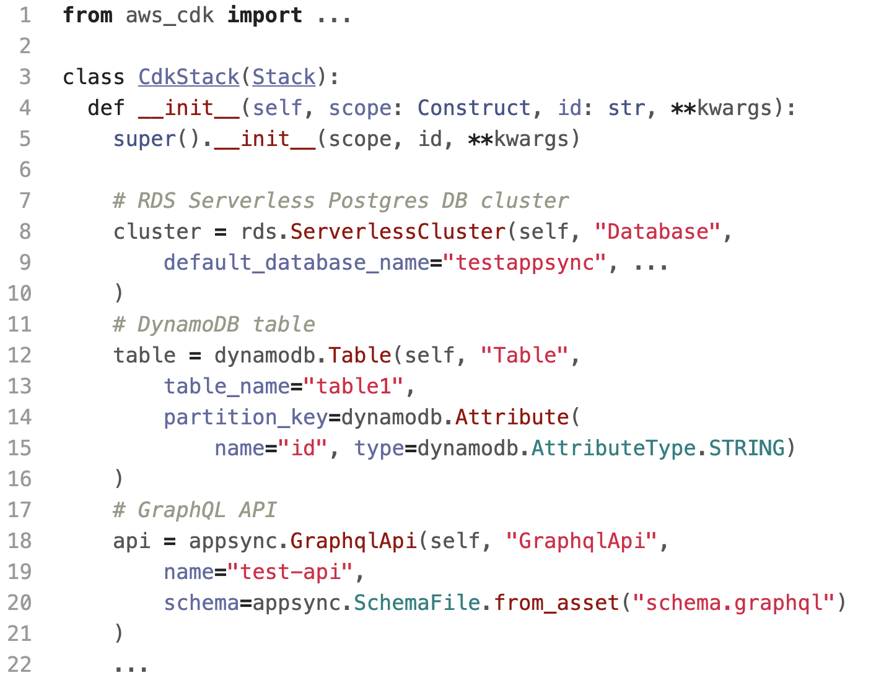
CDK Application
CDK script defines resources in a declarative way
We use cdklocal for deployment:
Deploy the resources (from cdk dir):
(There’s also a make target, for convenience:)
pip install aws-cdk-local
cdklocal bootstrap
cdklocal deploy
make deploy

Slide 28
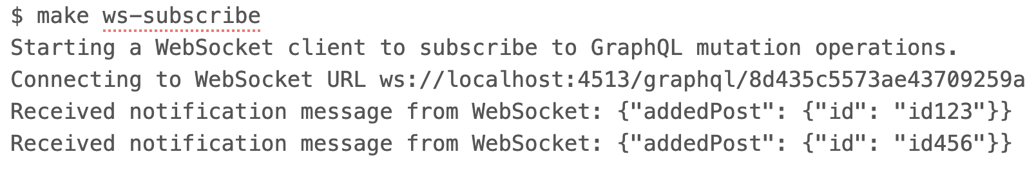
Interacting with the application
Once deployed, we can use an HTTP client to interact with the GraphQL API
→ see run.sh script in the repository
Adding items to the DynamoDB (or RDS) table:
Listing items from the DynamoDB (or RDS) table:
We can start a WebSocket subscriber in a separate terminal to receive notifications:
curl -d '{"query":"mutation {addPostDDB(id: \"id123\"){id}}"}' \
-H "x-api-key: …" … http://localhost:4566/graphql/$api_id
curl -d '{"query":"query {getPostsDDB {id}}"}' \
-H "x-api-key: …" … http://localhost:4566/graphql/$api_id

Slide 29
Misc. Integrations & LocalStack in CI Pipelines

Slide 30
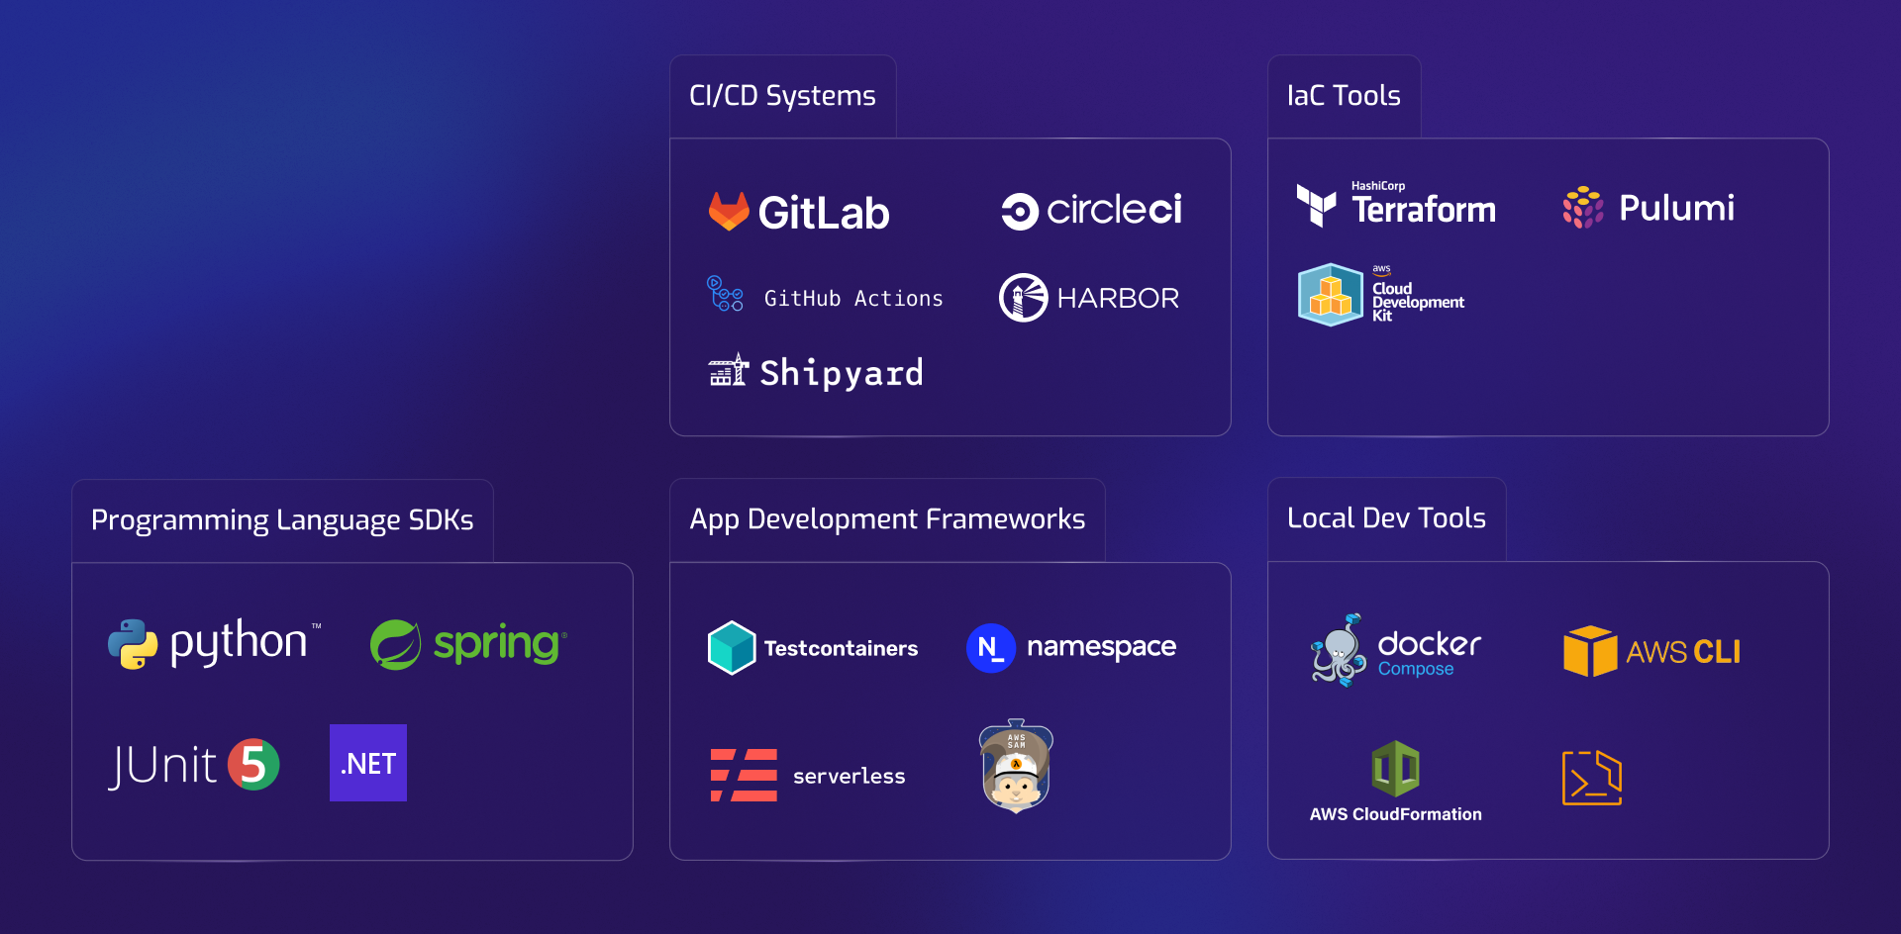
Growing Ecosystem
of Integrations

Slide 31
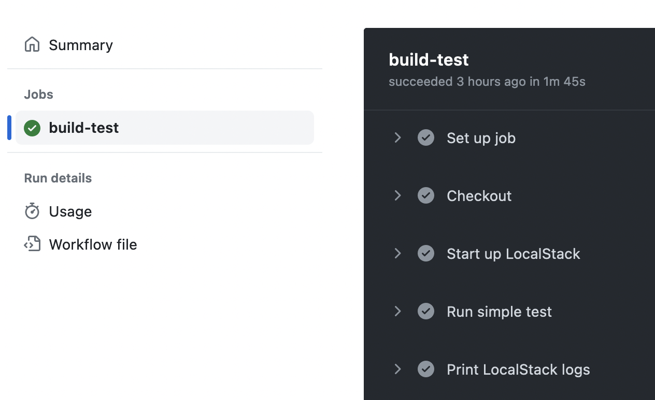
Taking a look at our CI configuration …
The Workshop project comes with a simple Github Actions CI
See configuration file under .github/workflows/build-test.yml
Easy to make the switch and promote changes
Local → CI/CD → staging → production
Using LocalStack in CI has several benefits:
Fosters repeatable builds, frequent testing
Full isolation: no resource naming conflicts
Quicker turnaround times (10x faster builds)
Less costs as compared to real cloud resources
…

Slide 32
Integration with other IaC Frameworks
LocalStack natively supports a number of other IaC and application dev. frameworks
Terraform
tflocal command-line: https://github.com/localstack/terraform-local
Pulumi
pulumilocal command-line: https://github.com/localstack/pulumi-local
Serverless.com Framework
serverless-localstack plugin: https://github.com/localstack/serverless-localstack

Slide 33
Sample 4: Cloud Pods & Persistence

Slide 34
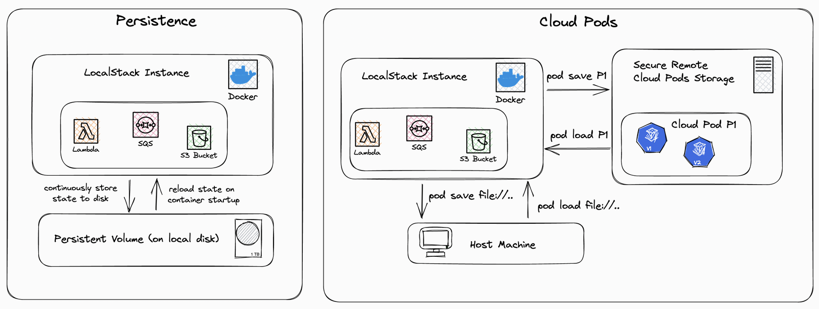
State Sharing via Cloud Pods
By default, the state in LocalStack is ephemeral, i.e., not persisted across restarts
Cloud Pods allow to take a persistent snapshot of the LocalStack application state
→ push it to a server, share it with team members, load it back into the instance, …

Slide 35
Cloud Pods can be stored locally or remotely
First, let’s create some resources - S3 buckets, SQS queues, …:
We can then store the state to a local cloud pod file:
Now - let’s restart the LocalStack instance, and load the state back in:
awslocal s3 mb s3://test-bucket
awslocal sqs create-queue –-queue-name q1
awslocal cognito-idp create-user-pool --pool-name p1
localstack pod save file://my-cloud-pod.zip
localstack pod load file://my-cloud-pod.zip

Slide 36
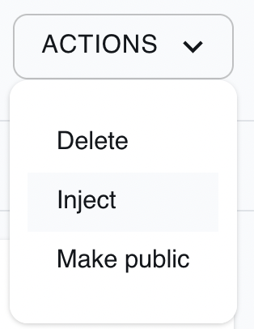
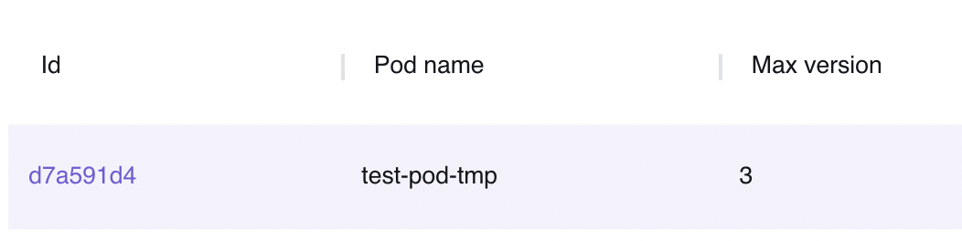
Remote: Let’s store and share some state!
First, create an S3 bucket and add some files to it:
Make sure your CLI and Web app are signed in using:
Choose a sufficiently random name, then save a cloud pod:
Browse the existing cloud pods in the Web application, then inject one!
https://app.localstack.cloud/pods
This way you can see the resources and files from your colleagues!
awslocal s3 mb s3://test-bucket
awslocal s3 cp local-file.png s3://test-bucket
demo@localstack.cloud
EuroPython23!
localstack pod save my-pod-512398

Slide 37
Wrap Up

Slide 38
Summary
In this tutorial, we’ve learned how to:
Install & configure LocalStack
On your your local machine, in Codespaces, and in your CI pipeline
How to develop and test AWS serverless applications fully locally
→ Lambda hot reloading helps speed up the local feedback cycles
How to seamlessly integrate IaC frameworks across local & CI/CD
Repeatability is key - spinning up sandbox environments to foster frequent testing
We’ve peeked into some advanced features
Cloud Pods for state sharing - opens up new possibilities for team collaboration
LocalStack integrations - various tools across the SDLC

Slide 39
Exciting Features in the Pipeline
LocalStack Extensions
Mechanism to plug in additional functionality into LocalStack
Several core use cases: fault injection, time simulation, hybrid setups (AWS proxy), etc
IAM Live Policy Generation
IAM can be a major pain point when working with AWS
We’re working on fully automated policy generation (based on observed user requests)
Ephemeral LocalStack Cloud Sandboxes
“1-click deploy” of a LocalStack instance that runs in a temporary remote instance
→ can be used to create preview environments of applications
Deeper integration of Cloud Pods & Stack Insights with CI builds
→ providing insights and facilitate debugging
… and much more!

Slide 40
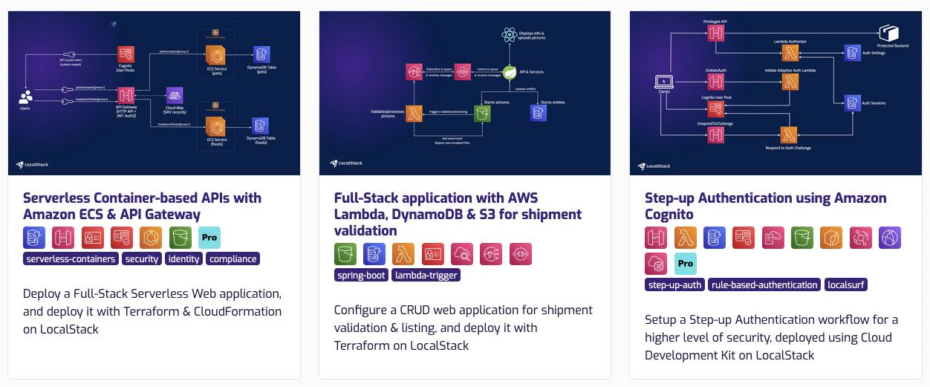
Docs & Developer Hub
Docs: Detailed list of services, config options, service coverage, etc
Developer Hub: Curated list of sample applications
https://docs.localstack.cloud/applications

Slide 41
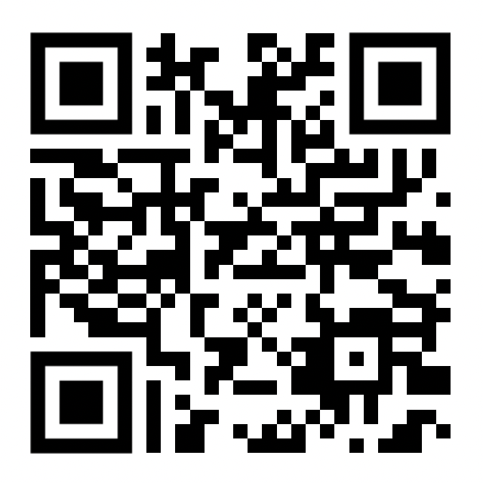
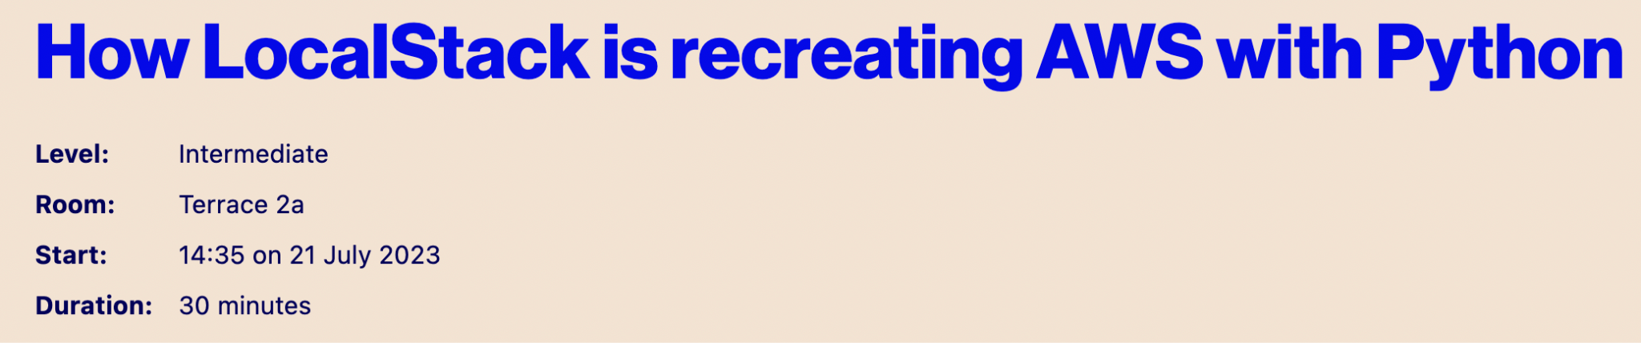
A Little Promo
Use the QR Code to get 3 months of LocalStack Pro for free!
Also: Please reach out to us if you’d like a deep-dive demo for your team 💻
We’d love to have you in our community:
Slack Community: https://slack.localstack.cloud
Monthly Meetups (online): https://meetup.com/localstack-community
Discuss Forum: https://discuss.localstack.cloud
Github: https://github.com/localstack/localstack
Check out this talk to learn about the internals of LS!! →
https://ep2023.europython.eu/session/ how-localstack-is-recreating-aws-with-python

Slide 42
Backup

Slide 43
Sample 4: Athena SQL queries over S3 files

Slide 44
Athena SQL Queries over S3
Following the steps in this sample application:
https://github.com/localstack-samples/sample-query-data-s3-athena-glue

Slide 45
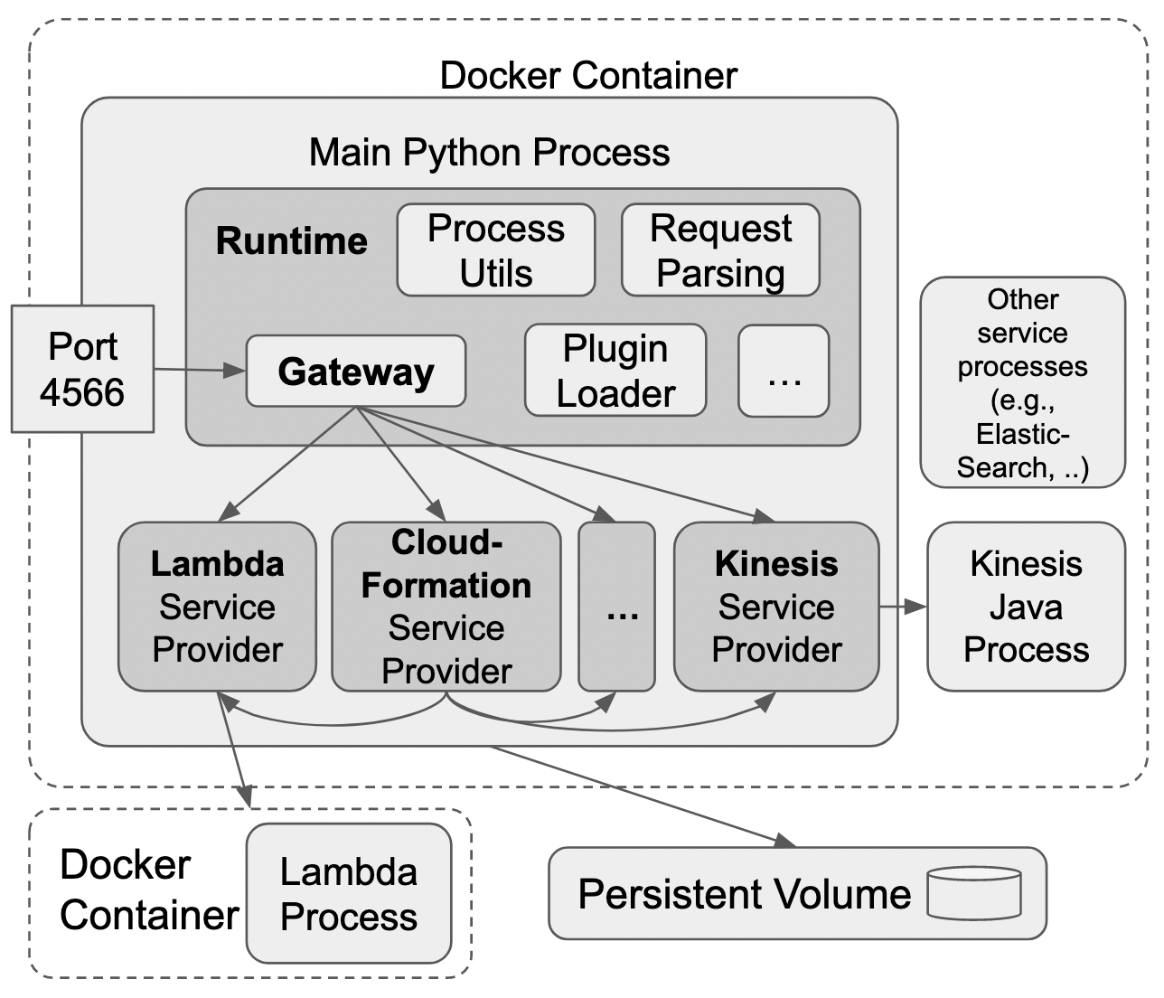
LocalStack Architecture Overview
Mini cloud operating system
Process management
File system abstractions
Event processing
Schedulers
Inter-service communication
Log management
…
Main design goals: lightweight, easy-to-use, cross-platform compatible

Slide 46
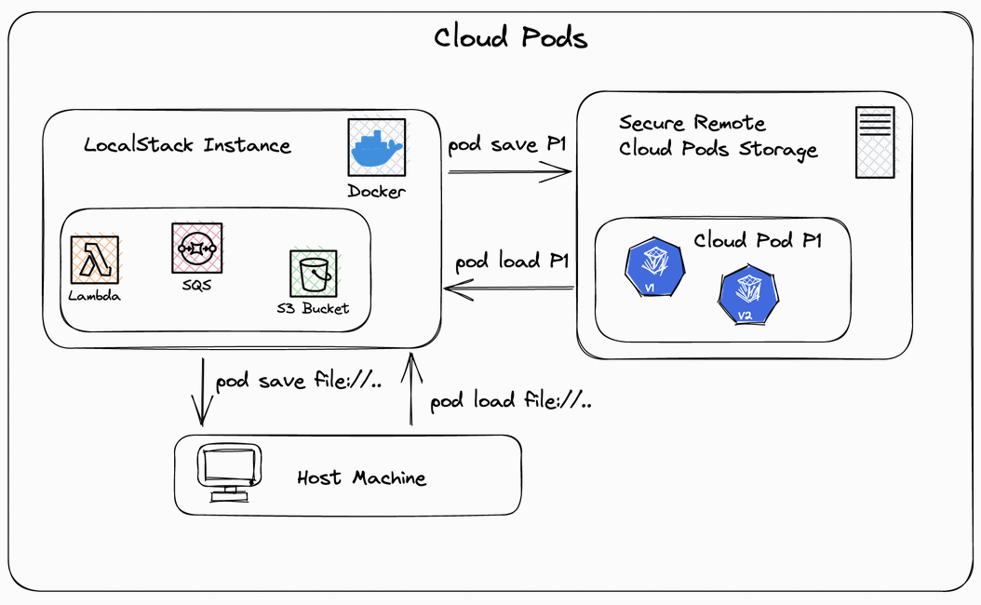
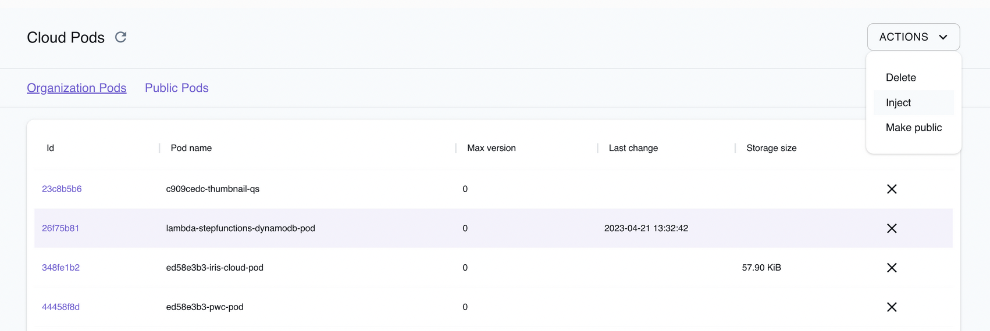
LocalStack Enterprise - Cloud Pods Storage
https://docs.localstack.cloud/user-guide/tools/cloud-pods
Convenient use of Cloud Pods
Taking a snapshot of the state of a LocalStack instance
Storing and versioning in managed storage
Facilitates team collaboration
Secure Managed Storage
Secure encrypted storage buckets per customer
Up to 5GB storage per user included
Alternative storage backends available for on-prem
E.g., OCI registries, FTP servers, git repos
Easy sharing within the team
Enable organization-wide access to pods
Browse and inject pods directly from the Web app

Slide 47
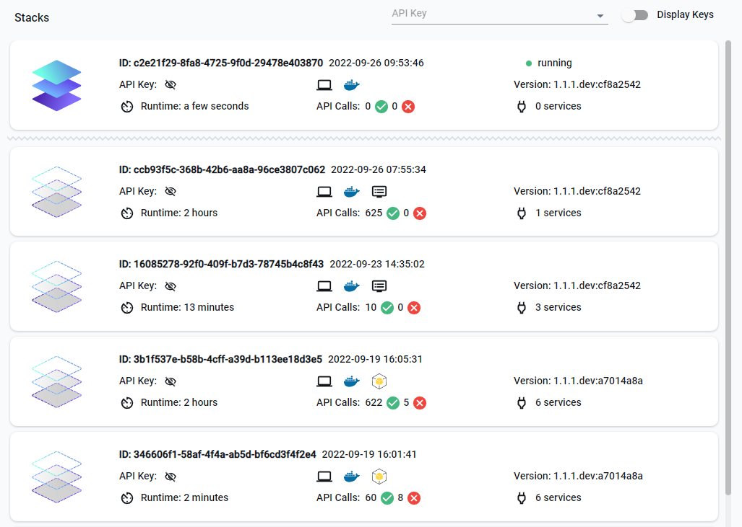
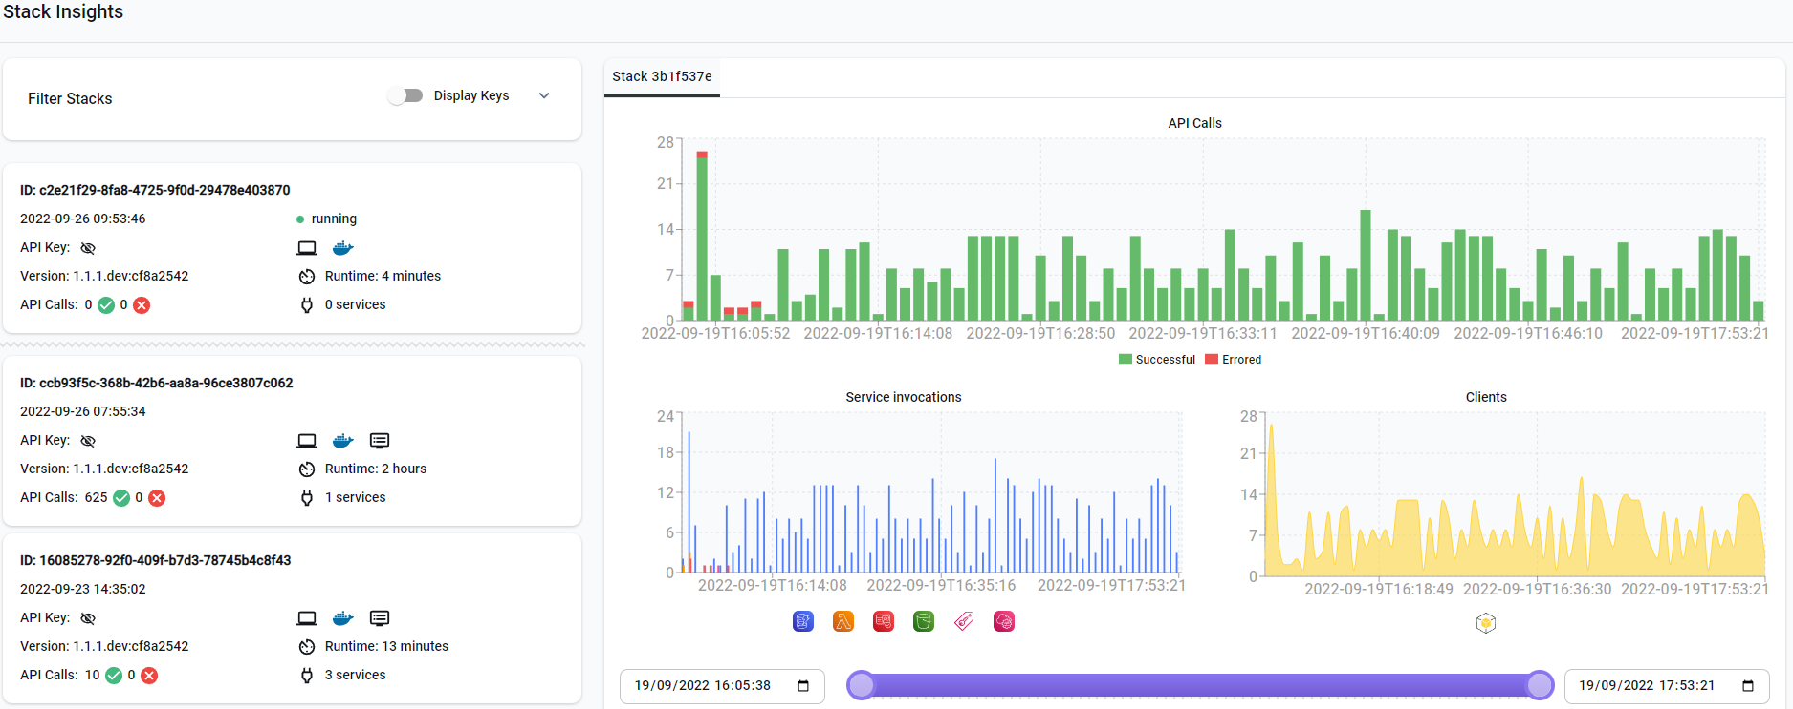
LocalStack Enterprise - Stack Insights
Inspect the current and historical state of LocalStack instances
Fine-grained access insights and debug logs

Slide 48
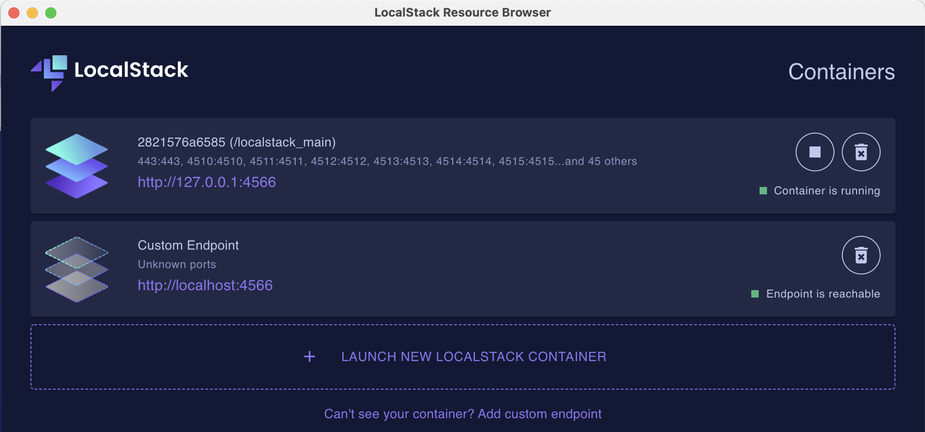
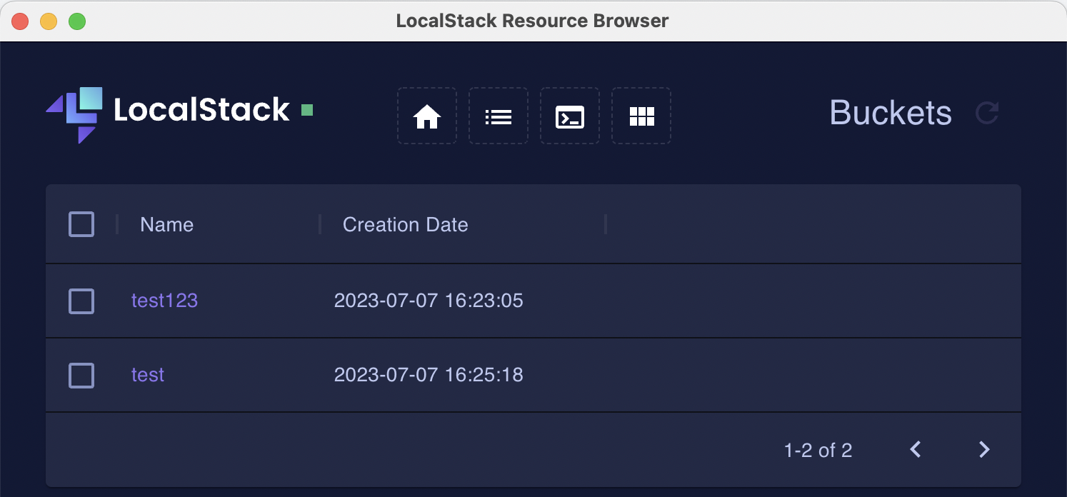
LocalStack Enterprise - Desktop App
Manage LocalStack instances
Starting/stopping/monitoring Docker containers
Control local or remote instances
Resource Browser
Simplified version of the AWS Console, running locally
Browse resources locally
Manage S3 buckets, Lambda functions, DynamoDB tables, etc
Convenient Desktop app for local/offline use
Alternative to our hosted Web application

Slide 49
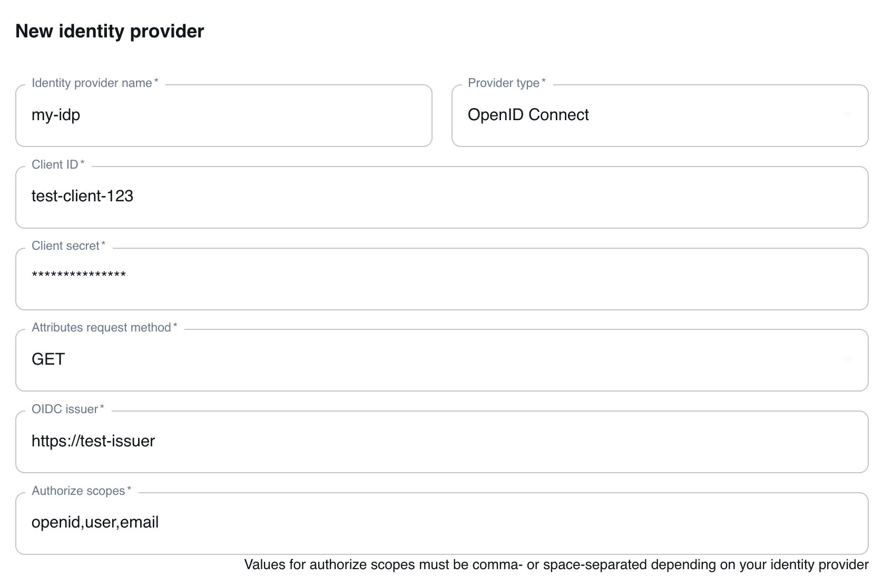
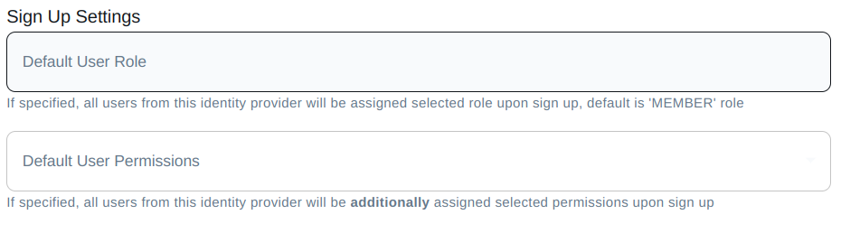
LocalStack Enterprise - SSO Support
Single Sign-On support based on standard protocols
Open ID Connect (OIDC)
Security Assertion Markup Language (SAML)
Easy integration with Azure Active Directory (AD), Okta, AWS Cognito, and other SSO providers
See docs for more details: https://docs.localstack.cloud/user-guide/ web-application/single-sign-on
Configurable default user roles and permissions
Predefined roles like member or admin
Fine-grained permissions for API key management, cloud pods usage, etc

Slide 50
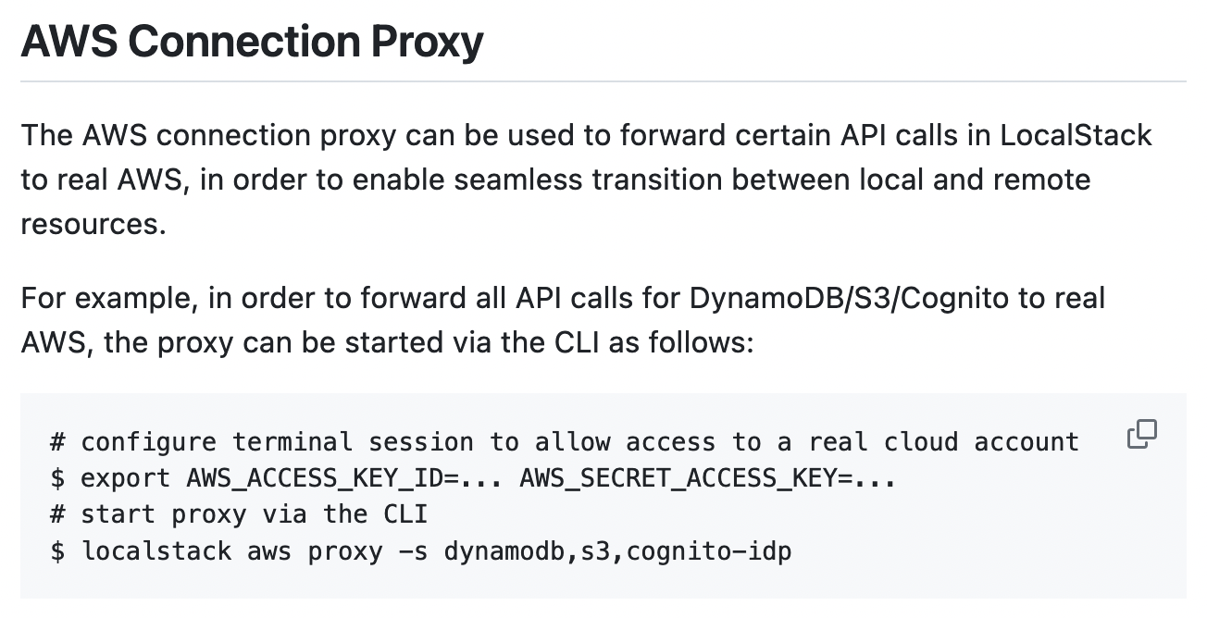
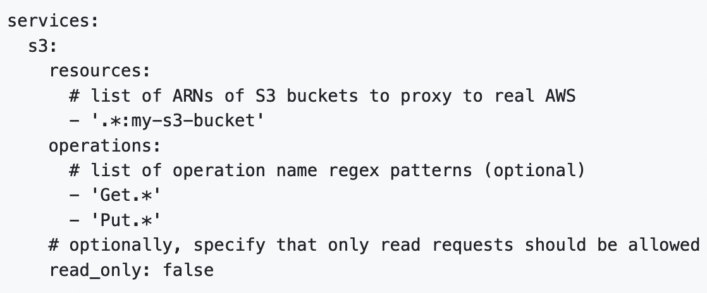
LocalStack Enterprise - Extensions
Example: AWS Replicator (Proxy) Extension
Bridging the gap between local execution and cloud resources
Enables “hybrid scenarios”
→ part of the application stack running locally, partly accessing remote resources in the cloud
Simplifies development and testing in large-scale scenarios
Integrates seamlessly with all LocalStack Tooling
E.g., awslocal, tflocal (Terraform), cdklocal (CDK), etc
Fine-grained configuration
Which resources are accessed locally or remotely
Either on the service- or on the resource-level
Other custom extensions available on-demand
E.g., fault injection testing, third-party emulators, etc

Slide 51
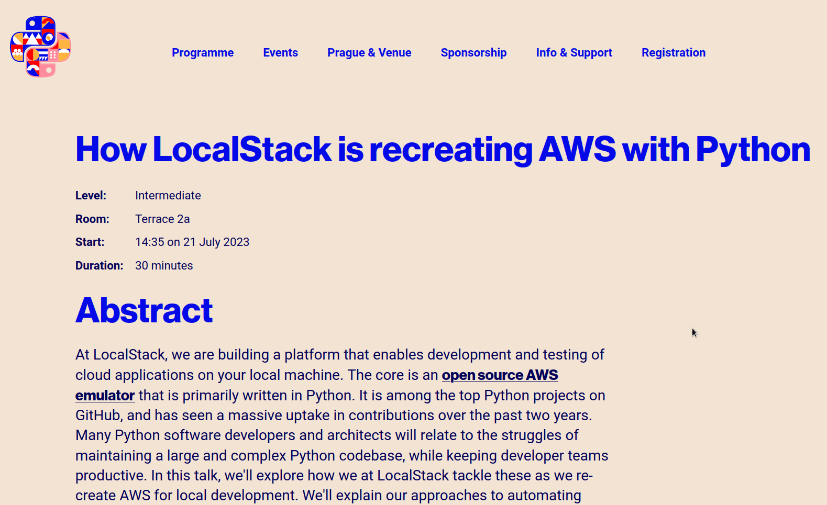
Friday 14:35

